Slide 1
Conditionals - part 1
Barb Ericson
Georgia Institute of Technology
May 2006

Slide 2
Learning Goals
Understand at a conceptual and practical level
  How to conditionally execute a statement or a block of statements
  How to remove red-eye from a picture

Slide 3
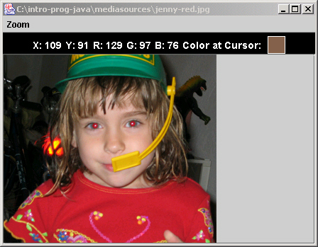
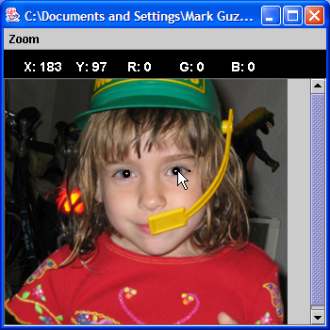
Remove Red Eye
Red eye is when the flash from the camera is reflected from the subject’s eyes
We want to change the red color in the eyes to another color
  But not change the red of her dress
Notes:
See http://science.howstuffworks.com/question51.htm for more information on red-eye.

Slide 4
Red Eye Algorithm
We can find the area around the eyes to limit where we change the colors
  Using pictureObj.explore()
  But we still just want to change the pixels that are “close to” red.
  We can find the distance between the current color and our definition of red
    And change the color of the current pixel only if the current color is within some distance to the desired color

Slide 5
Detailed Red Eye Algorithm
Loop with x staring at some passed start value and while it is less than some passed end value
  Loop with y starting at some passed start value and while it is less than some passed end value
    Get the pixel at this x and y
    Get the distance between the pixel color and red
    If the distance is less than some value (167) change the color to some passed new color

Slide 6
Conditional Execution
Sometimes we want a statement or block of statements executed only if some expression is true
  We can use the “if” statement in Java
  if (colorDistance < value)
    Statement or block to execute
  next statement
false
if (expression)
true
Statement or block
statement
Notes:
Use indentation to make your code easier for other people to read. It doesn’t matter to the compiler.
Remember that a block of statements in Java is inside {}.

Slide 7
Using if Exercise
Open DrJava and try this in the interactions pane
  int x = 2;
  if (x > 1) System.out.println(“X is > 1”);
    System.out.println(“X is “ + x);
    x = 0;
  if (x > 1) System.out.println(“X is > 1”);
    System.out.println(“X is “ + x);

Slide 8
Blocks of Statements
The if statement will conditionally execute
  the following statement or
  A block of statements
  if the test is true
To conditionally execute a block of statements
  Enclose them in ‘{‘ and ‘}’
Indent the following statement or block of statements
  To make it easier to read
It is good practice to always enclose conditional statements in a block
  Less likely to cause an error if the code is modified

Slide 9
Color Distance
The distance between two points is computed as
  Square root of (( x1 – x2)² + (y1 – y2)²)
The distance between two colors can be computed
  Square root of ((red1 – red2)² + (green1-green2)² + (blue1 – blue2)²)
  There is a method in the Pixel class to do this
    double dist = pixelObj.colorDistance(color1);

Slide 10
Remove Red Eye Method
public void removeRedEye(int startX, int startY, int endX,
int endY, Color newColor)
{
Pixel pixelObj = null;
// loop through the pixels in the rectangle defined by the // startX, startY, and endX and endY
for (int x = startX; x < endX; x++)
{
for (int y = startY; y < endY; y++)
{
// get the current pixel
pixelObj = getPixel(x,y);

Slide 11
Remove Red Eye Method
// if the color is near red then change it
if (pixelObj.colorDistance(Color.red) < 167)
{
pixelObj.setColor(newColor);
}
}
}
}
Notes:
You don’t have to enclose the pixelObj.setColor statement in a block since it is just one statement but it makes the good easier to read and maintain.

Slide 12
Testing removeRedEye
Use the picture explorer to find the values for start x, start y, end x, and end y
Try the following to test removeRedEye
String file =
FileChooser.getMediaPath(“jenny-red.jpg”);
Picture p = new Picture(file);
p.explore();
p.removeRedEye(startX,startY,endX,endY, Color.awt.BLACK);
p.explore();

Slide 13
Challenge
Take a picture of a friend
  And try to change their eye color
  Try to change their hair color
  Try to change their clothing color
Can you write one method to do this?
  And call it several times with different parameters?

Slide 14
Summary
Use the if statement to conditionally execute another statement or a block of statements
    if (boolean test)
    statement
    if (boolean test)
    {
    // statements to execute if the test is true
    }

